Slide 1
RETAIL ANALYTICS CENTER OF EXCELLENCE
Black Friday Sales Analysis
Executive Insights & Strategic Recommendations
550,068 transactions • 5,891 customers • 3,631 products
Presented by - Abha Verma
Batch - Data Analytics Course(#01701)
Learners id - 24CRD04709
Project Mentor - Shaghil Jamal
Tools and Technologies - Excel, Sql, Python, Statistics, PowerBi

Slide 2
CONTENTS
What this presentation covers
01
Performance Overview
Core KPIs framing the campaign's results
02
Top 5 Insights
Data-backed findings on customers, cities & categories
03
Strategic Recommendations
Four actions tied directly to the insights
04
Growth Roadmap
Five pointers to improve performance and drive growth
05
Future Scope
Where this analysis goes next
06
Methodology & Limitations
How we tested the hypotheses, and what to watch for
BLACK FRIDAY SALES ANALYSIS
2

Slide 3
SECTION 01
Performance Overview
Six KPIs frame the scale and shape of this Black Friday campaign.
₹509.6 Cr
5,891
₹9,264
Total Sales
Distinct Customers
Avg Purchase / Txn
Total revenue across all transactions
Unique shoppers in the campaign
Average basket value per line item
₹8.65 L
55.3%
9.6
Avg Spend / Customer
High-Value Share
Avg Category Breadth
Average total revenue per shopper
Revenue from top 20% of customers
Distinct categories bought per customer
BLACK FRIDAY SALES ANALYSIS
3

Slide 4
INSIGHT 1 OF 5
A small core of customers drives over
half of all revenue
The top 20% of customers by spend generate 55.3% of total revenue — a Pareto-style concentration. Losing even a small share of this group would have an outsized impact on total sales.
Top 20% of customers = 55.3% of revenue
Implication: retention among top spenders matters more than broad acquisition for protecting revenue.
BLACK FRIDAY SALES ANALYSIS
4

Slide 5
INSIGHT 2 OF 5
City A & B run deep; City C runs wide
but shallow
Customers vs. Avg Transactions
City A (Metro)
141.4 avg txns
1,045 customers
City B
135.4 avg txns
1,707 customers
City C
54.5 avg txns
3,139 customers
City C has 3,139 customers — the largest base — but averages just 54.5 transactions each, versus ~140 in City A/B. That frequency gap, not price sensitivity, explains the spend gap.
BLACK FRIDAY SALES ANALYSIS
5

Slide 6
INSIGHT 3 OF 5
The 26–35 age group is the single
largest revenue driver
39.9%
of total sales comes from customers aged 26–35 — more than the next two age groups combined.
Statistical check
One-way ANOVA confirms purchase amount differs significantly across age groups:
F = 40.58, p < 0.001
BLACK FRIDAY SALES ANALYSIS
6

Slide 7
INSIGHT 4 OF 5
Revenue is heavily concentrated in
one product category
Product Category 1 alone accounts for 37.5% of total revenue — more than double the next-largest category.
Strength
A reliable, proven core revenue driver the business can count on.
Risk
Over-dependence on one category increases exposure if demand there softens.
Opportunity
Customers already buy across 9.6 categories on average — clear room to cross-sell into adjacent, underpenetrated categories.
BLACK FRIDAY SALES ANALYSIS
7

Slide 8
INSIGHT 5 OF 5
Gender shows a real spending gap;
marital status does not
SUPPORTED
NOT SUPPORTED
Gender → Spend
Marital Status → Spend
76.7% of revenue comes from male customers, and their average transaction value is significantly higher.
No meaningful difference in spend between married and single customers, despite this being one of our original hypotheses.
Welch's t-test: t = 46.36, p < 0.001
Welch's t-test: t = 0.34, p = 0.73
→ Gender-based targeting is empirically supported.
→ Don't build personas around marital status.
BLACK FRIDAY SALES ANALYSIS
8

Slide 9
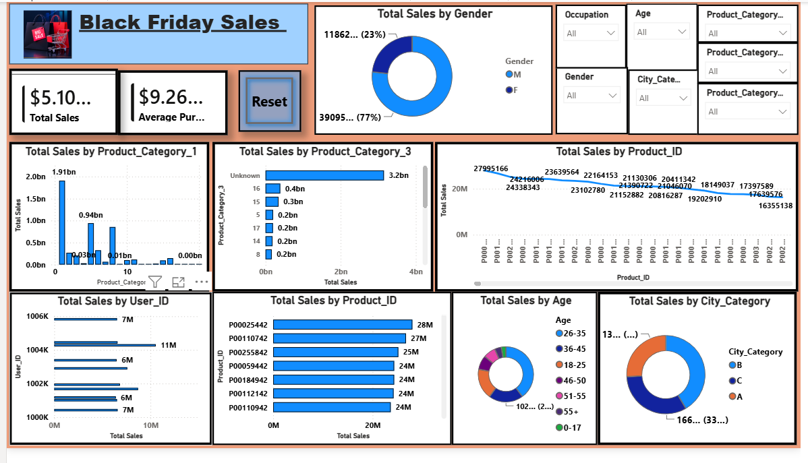

Slide 10
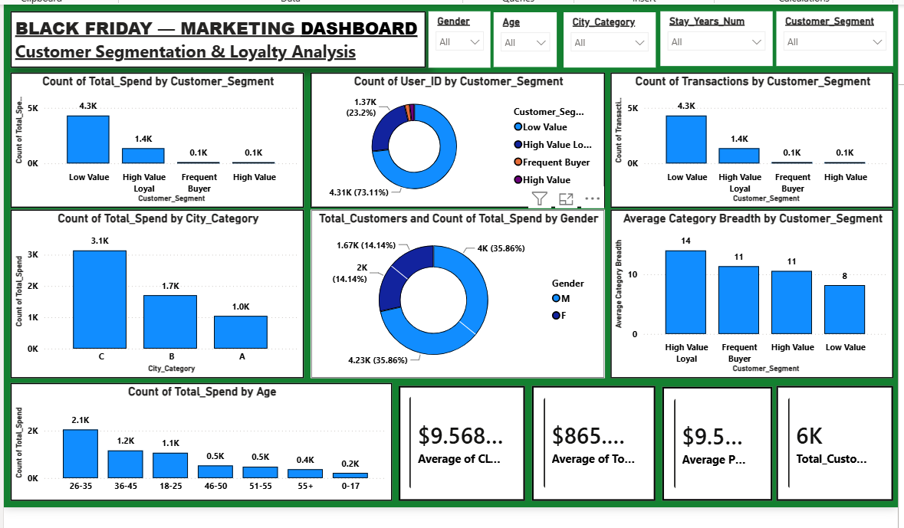

Slide 11
SECTION 03
Strategic Recommendations
Four actions, each tied directly to an insight above and prioritized by expected revenue impact.
01
02
Launch a tiered loyalty program
Run frequency campaigns in City C
Target the top 20% of spenders with early access, free-shipping thresholds, and point multipliers.
Use bundles and repeat-purchase incentives rather than blanket discounts — City C's issue is engagement depth, not price.
Impact: Protects 55% of revenue at low incremental cost.
Impact: Largest lever given City C's 3,139-customer base.
03
04
Cross-sell out of Category 1
Segment by gender & age, not marital status
Bundle top-category purchases with underpenetrated categories, using existing 9.6-category breadth patterns.
Reallocate campaign budget toward statistically supported segments (26–35, gender-differentiated).
Impact: Reduces single-category revenue risk.
Impact: Improves marketing ROI on proven signals.
BLACK FRIDAY SALES ANALYSIS
9

Slide 12
SECTION 04
Growth Roadmap: 5 Ways to Improve
Beyond the four strategic actions above, these five pointers close the gaps this analysis surfaced and build toward sustained growth.
1
Capture transaction timestamps
Add a date/time field going forward so 'repeat purchase' can be measured as true purchases-over-time, not just line-item count — the biggest gap in this dataset.
2
Move to a real-time sales dashboard
Connect Power BI/Tableau directly to the live POS/e-commerce feed so category and city performance can be monitored during the sale, not only after it.
3
Build a category-affinity recommendation engine
Use the 9.6-category average breadth per customer to power 'customers who bought this also bought' prompts at checkout, directly extending Insight 4.
4
Track channel & campaign attribution
Log online vs. in-store and which promotion drove each purchase — this is what would let the business finally answer 'is marketing ROI real, or just shifted demand?'
5
Pilot demand forecasting for Category 1
Given its 37.5% revenue concentration, even a simple forecasting model here would meaningfully de-risk inventory planning for the next mega-event.
BLACK FRIDAY SALES ANALYSIS
10

Slide 13
SECTION 05
Future Scope & Next Steps
Where this analysis extends next, following the project's original SQL → Python → BI roadmap.
01
02
SQL data pipeline & automation
Predictive & ML modeling
Formalize the black_friday_data schema in SQL with scheduled ingestion, so Python and BI tools always query fresh data.
Layer regression or ML models on this EDA to forecast next-event sales and flag high-churn-risk customers ahead of time.
Why it matters: Turns this one-time analysis into a repeatable system.
Why it matters: Moves the team from reporting the past to planning the future.
03
04
Omnichannel & geographic expansion
Continuous customer feedback loop
Extend data capture beyond City A/B/C to online-only shoppers and new geographies as the retailer grows.
Pair transactional data with post-purchase surveys to explain why segments behave as they do, not just how.
Why it matters: Keeps segmentation accurate as the customer base changes.
Why it matters: Adds the qualitative 'why' behind every stat in this deck.
BLACK FRIDAY SALES ANALYSIS
11

Slide 14
METHODOLOGY & LIMITATIONS
How we tested this, and what to keep in mind
Significance testing
Welch's t-test (unequal variances) for two-group comparisons; one-way ANOVA for multi-group comparisons. All tests at α = 0.05.
Grain of the data
One row per product line item, not per order or per visit — 'transactions' in this deck means line items.
No date field
The dataset has no transaction timestamp, so 'repeat purchase' reflects transaction count per customer, not purchases over time.
Masked categories
Product and occupation categories are anonymized codes, which limits category-specific business interpretation.
Retail Analytics Center of Excellence | Black Friday Sales Analysis
12

Slide 15
RETAIL ANALYTICS CENTER OF EXCELLENCE
Thank You
Black Friday Sales Analysis — Executive Insights & Strategic Recommendations
Prepared and presented by
Abha Verma
Data Analytics Consultant | Data Analytics with GenAI — Capstone Project
13

